Slide 1
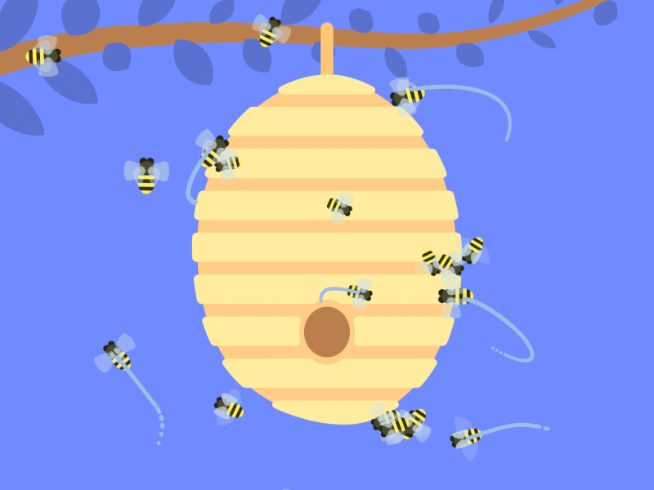



(“double-apl”)
A Practical Agent Programming Language
Final Presentation
Alvaro Armada Ruiz | Benedikt Krauss | Hajar Lachheb |
Rubén Vera Garcia | Zixi Chen
MASD Course - Universitat Politècnica De Catalunya

Slide 2

TABLE OF CONTENTS
01
02
03
04
05
Problem To Solve
Multi-Agent Design
Prototype
Agent Framework
Language Analysis

Slide 3
Problem To Solve
01

Slide 4
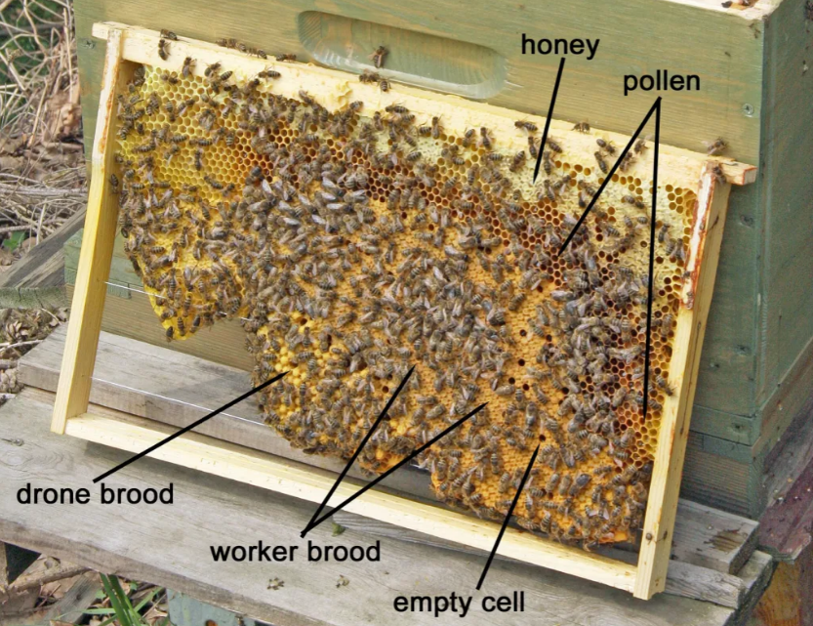
Description of the problem to solve
Bee Colony Resource Management and Survival
Actors: Worker Bee, Queen Bee, Drone Bee
Environment: Hive, Flower, Predator
3 scenarios: Foraging, Swarm Formation & Predator Threat

Slide 5
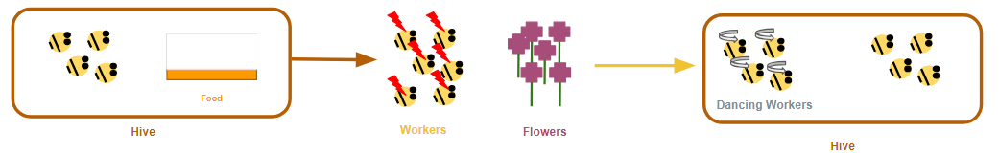
Description of the problem to solve
Scenario 1: Foraging
Worker Bee Agents detect a decrease in food stores within the hive.
The Hive Agent releases a pheromone indicating the need for foraging.
Worker Bee Agents receive the pheromone signal and start searching for Flower Agents in the environment.
Worker Bee Agents that find nectar sources return to hive and perform a "Round Dance" to communicate the proximity of the food source.
Other Worker Bee Agents observe the dance and join in to learn the location of the food source.
Worker Bee Agents that locate distant nectar sources perform a "Waggle Dance" to communicate direction and distance of the food source.
Worker Bee Agents interpret the Waggle Dance and adjust their foraging behavior accordingly.

Slide 6
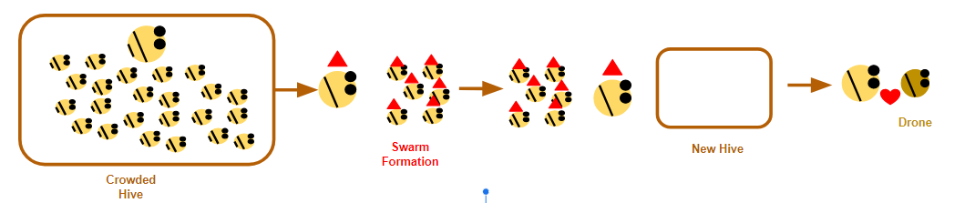
Description of the problem to solve
Scenario 2: Swarm Formation
Queen Bee Agent detects a crowded hive and decreases resource availability.
The Queen Bee Agent performs a "Swarm Dance" to communicate the need for swarm formation.
Worker Bee Agents observe the Swarm Dance and prepare for swarm formation.
Queen Bee Agent performs a "Queen Piping" behavior to signal the readiness for swarm departure.
Worker Bee Agents follow the Queen Bee Agent and engage in swarm flight to search for a new hive location.
Drone Bee Agents perform a "Congregation Dance" to communicate the location of drone congregation areas for mating.

Slide 7
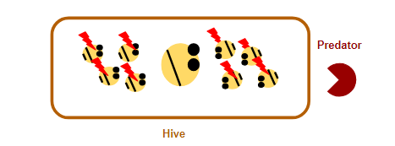
Description of the problem to solve
Scenario 3: Predator Threat
Predator agent approaches the hive (queen), posing a threat to the colon
Worker agent detects the presence of the predator through sensory inputs and alerts Queen agent.
Queen agent performs “Alarm Dance” to alert Worker agents about the danger.
Worker agents engage in defensive behavior, such as forming a defensive cluster.
Worker agents maintain their defensive position, and do not move while predator agents approaches.
Predator agent interacts with worker agents, attempting to invade the hive.
Worker agents work together to discourage the predator and protect the hive.

Slide 8
Why Multi-Agent system design?
Decentralized Decision-Making
Emergent Behavior
Division of Labor
Communication and Information Exchange
Robustness and Adaptability
Scalability

Slide 9
Multi-Agent Design
02

Slide 10
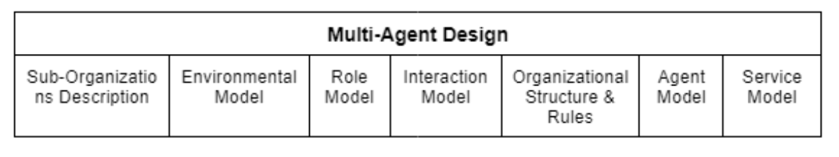
2. Multi-Agent Design
Our Multi-Agent Design is based on GAIA v.2 and takes these elements into consideration :
Sub Organizations Description
Environmental Model
Role Model
Interaction Model
Organizational Structure and Rules
Agent & Service Model

Slide 11
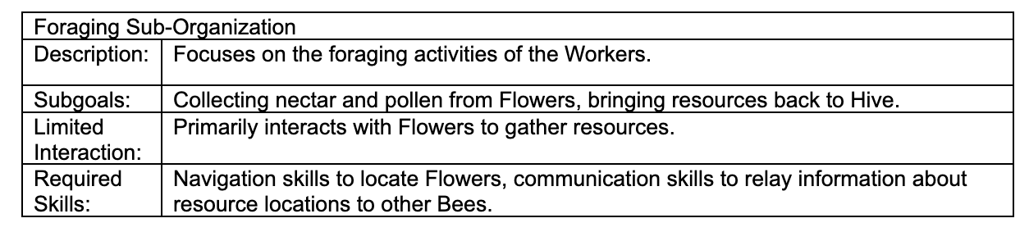
2. Multi-Agent Design
Sub-Organization

Slide 12
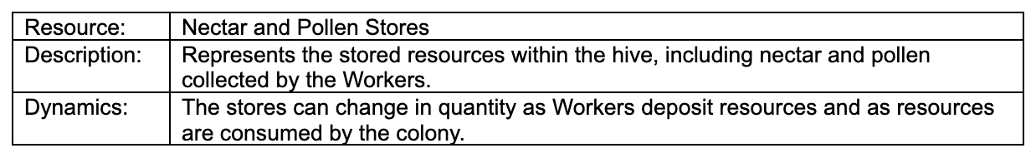
2. Multi-Agent Design
b. Environmental Model

Slide 13
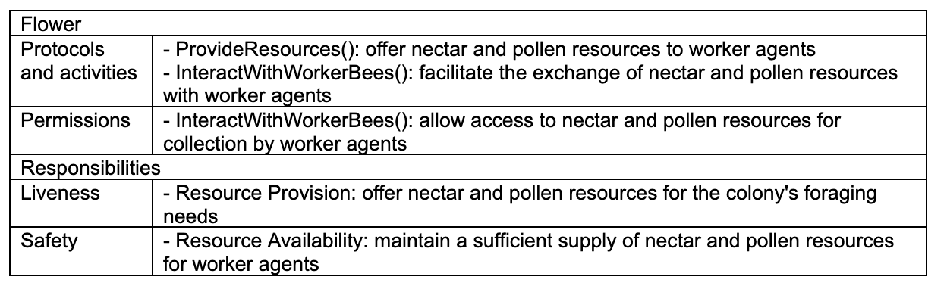
2. Multi-Agent Design
c. Role Model

Slide 14
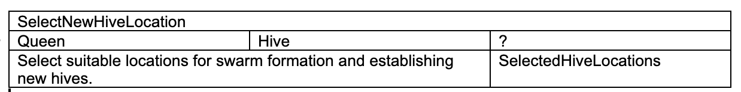
2. Multi-Agent Design
c. Interaction Model

Slide 15
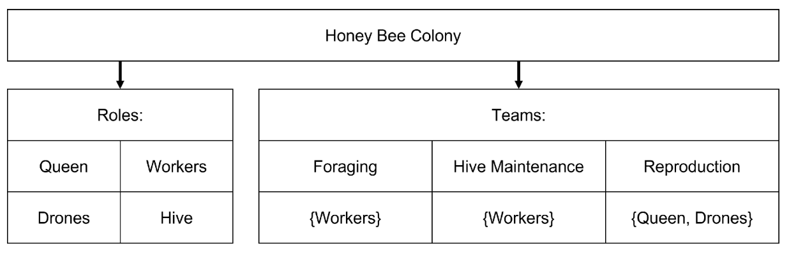
2. Multi-Agent Design
d. Organization Structure

Slide 16
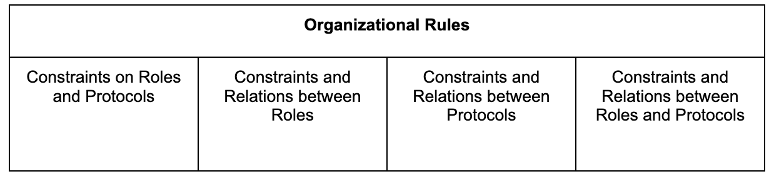
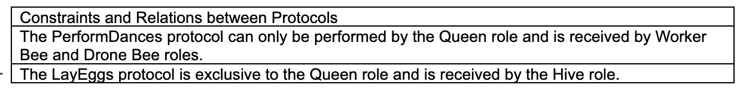
2. Multi-Agent Design
e. Organization Rules

Slide 17
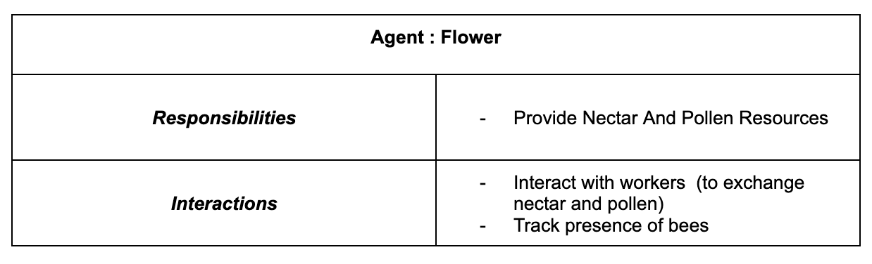
2. Multi-Agent Design
f. Agent Model

Slide 18
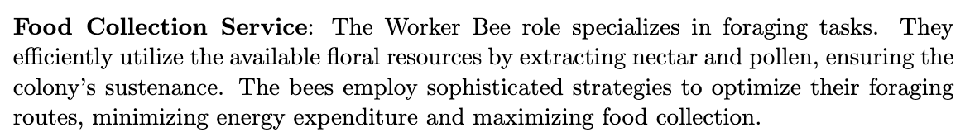
2. Multi-Agent Design
j. Service Model

Slide 19
Prototype
03

Slide 20
3. Prototype
Which are the main abstractions that define the agent behavior?
Java-based Library - Scenario 3: Predator threat
One Queen bee agent
Three Worker bee agents
One Predator agent

Slide 21

Queen/Hive Agent
Queen and Hive simplified as one static agent
First version
Receive predator alert from worker bee
Send alarm dance to all worker bees
Second version
Receive predator alert from worker bee
Alarm dance sent from the bee detecting the predator

Slide 22

Worker Agent
Worker moves randomly until a predator is detected
First version
Detect predator and sent alarm dance to Queen bee
Wait until alarm dance from Queen to go to defensive position
Second version
Detect predator and sent alarm dance to all bee agents
Go to defensive positions

Slide 23

Predator Agent
Predator moves, searching for the Hive with a probability
When Predator founds the Hive, move to Hive location
Retreat from Hive location
Worker bees have defended the Hive
Predator has attacked successfully

Slide 24
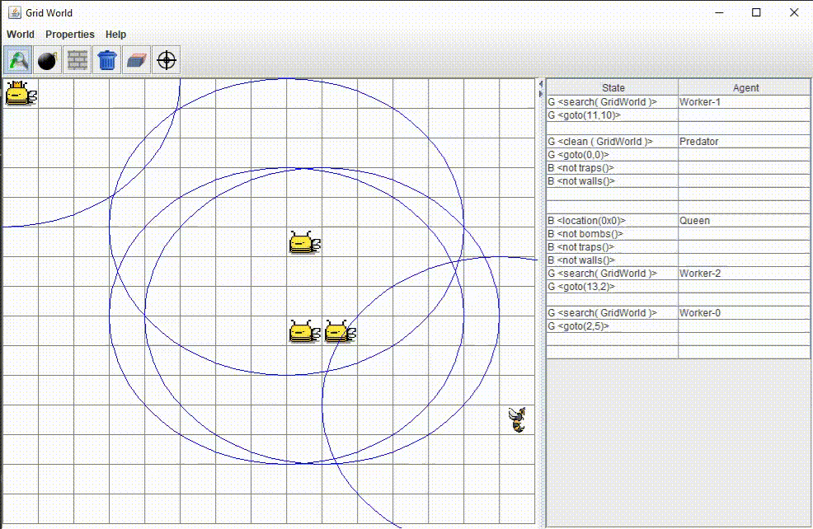
Demonstration

Slide 25
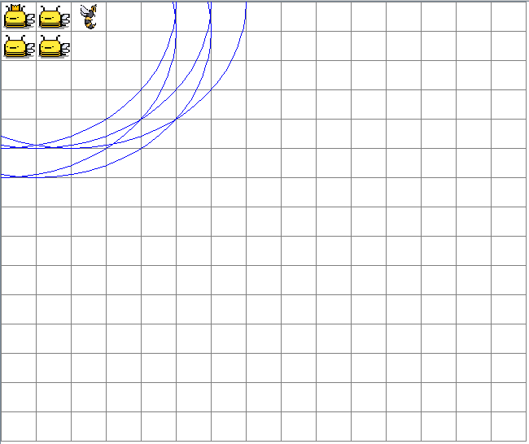
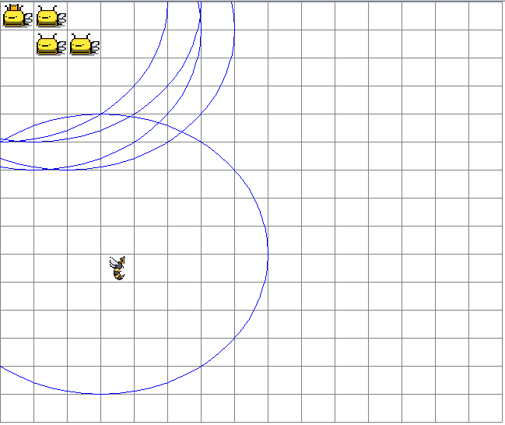
Possible outcomes (I)
Perfect protection (≈70%)
Partial protection (≈20%)

Slide 26
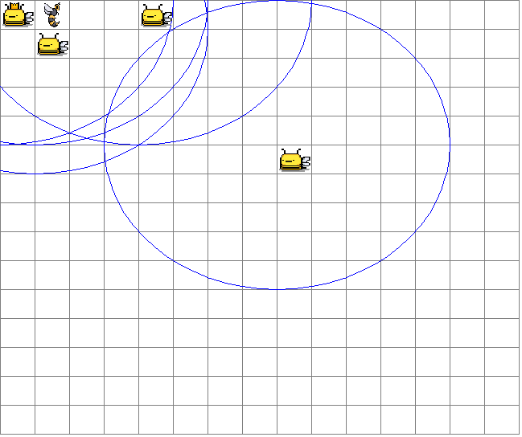
Possible outcomes (II)
Unsatisfactory protection(≈10%)

Slide 27
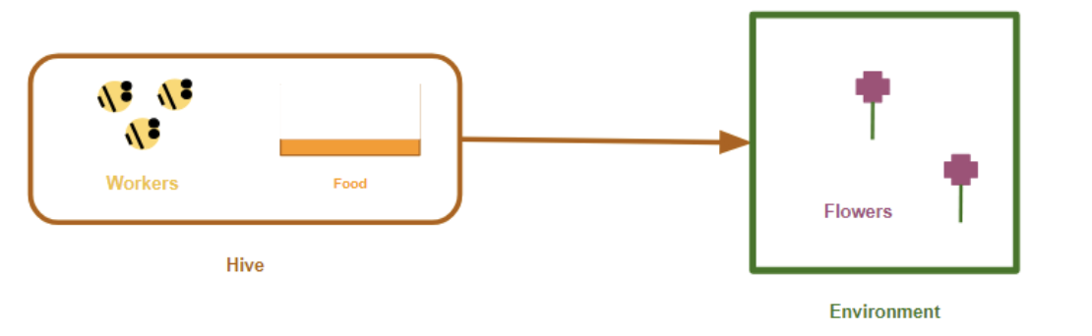
3. Prototype
Which are the main abstractions that define the agent behavior?
2. Hybrid Programming Platform
One Queen bee agent
Three Worker bee agents
Two Flower agents

Slide 28
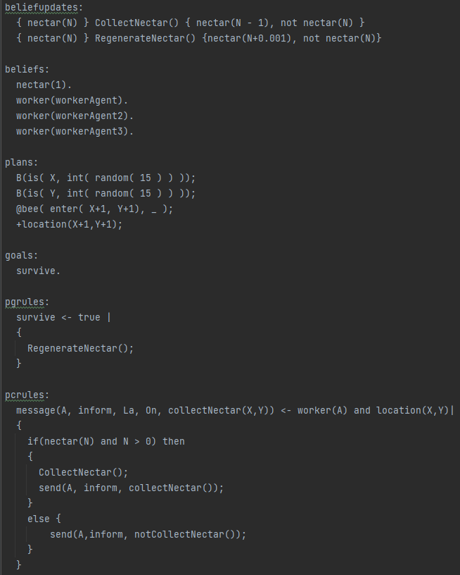
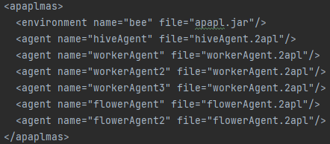
Flower Agent

Slide 29
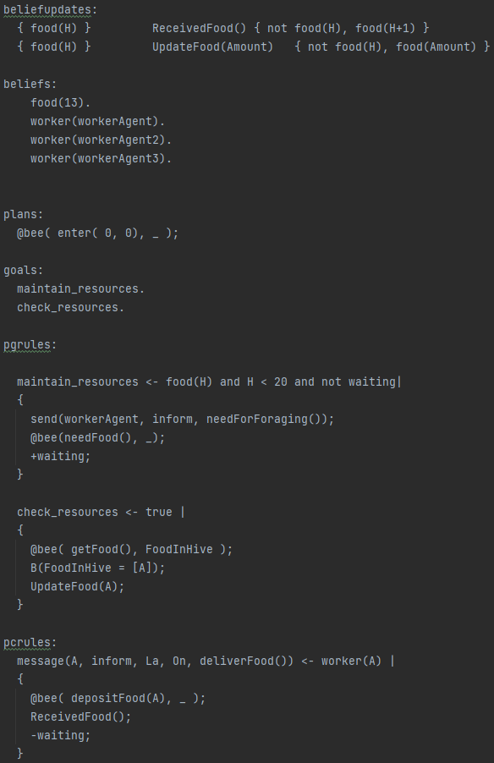
Hive Agent

Slide 30
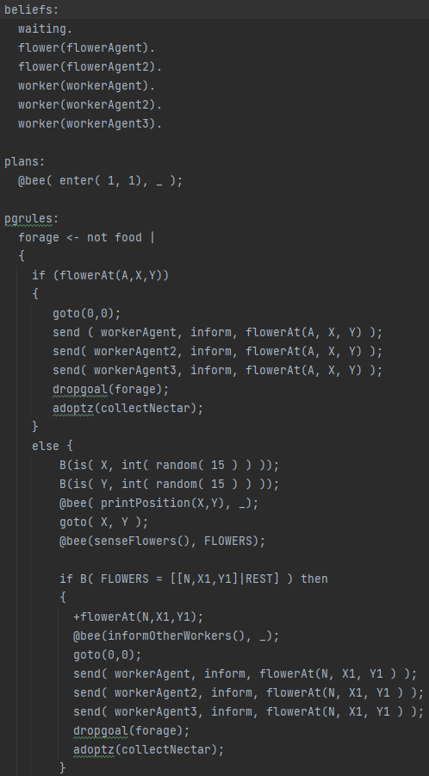
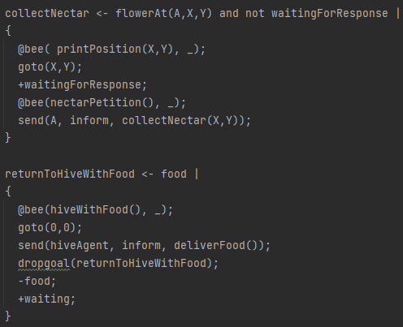
Worker Agent

Slide 31
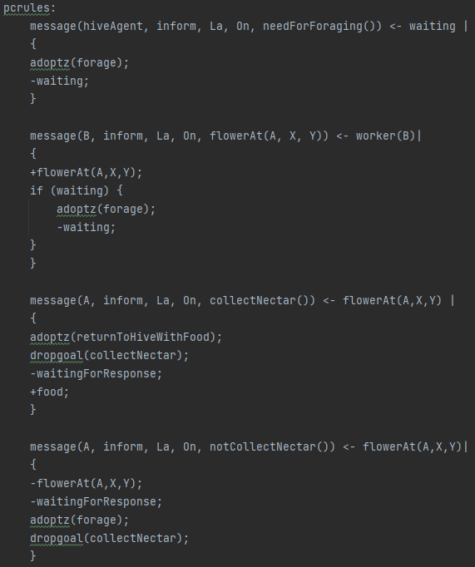
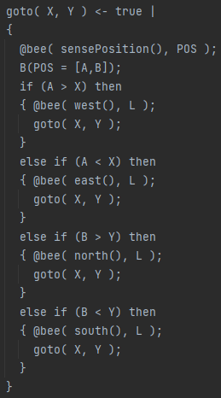
Worker Agent

Slide 32
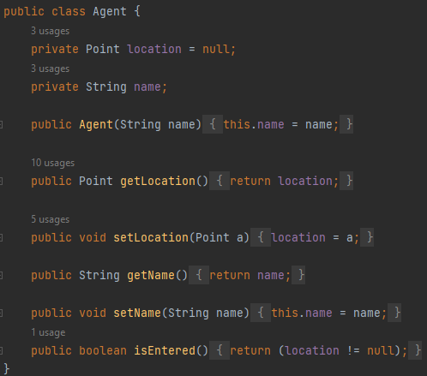
Java Environment

Slide 33
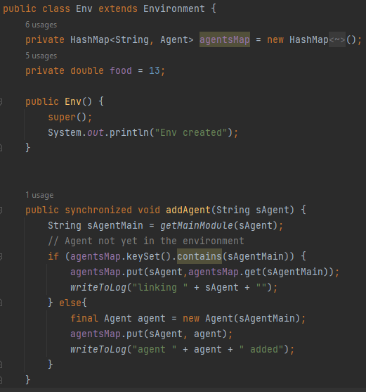
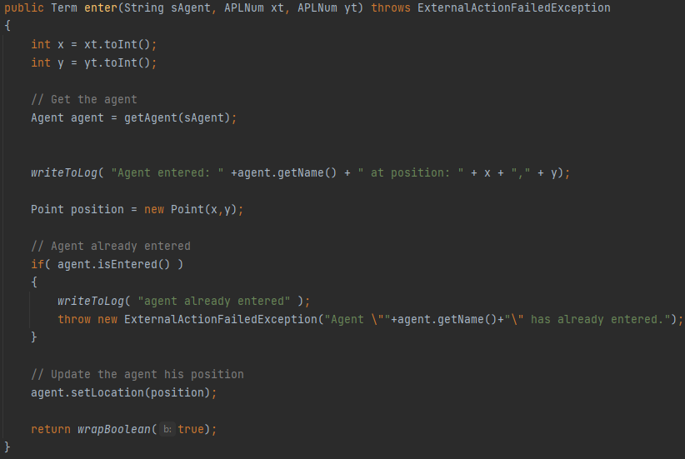
Java Environment

Slide 34
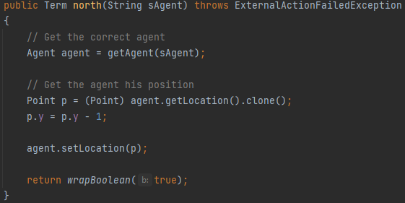
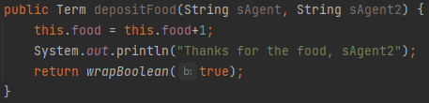
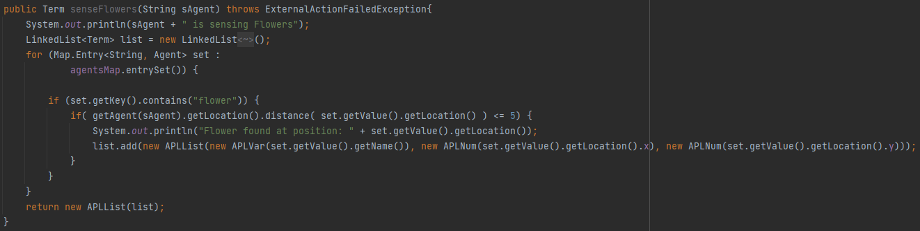
Java Environment

Slide 35

Demonstration

Slide 36
Agent Framework
04

Slide 37
4. Updated Description of the Agent Framework
In this part, we made sure to update the agent framework corresponding to the 2APL Language for both of it corresponding versions.
Hybrid Version of 2APL:
Agent framework: beliefs, actions, rules, goals, plans, modules.
1.Actions: represent the executable behaviors or operations that an agent can perform. There are different types of actions, including belief update actions, test actions, goal dynamics actions, abstract actions, communication actions and external actions.
2.Rules: define the decision-making and reasoning process of an agent. There are three types of rules: Percept-Goal Rules, Percept-Condition Rules, Plan Rules. Rules consist of conditions and actions that guide the agent’s behavior.
3.Modules: a way to organize and structure agent programs. They allow agents to encapsulate their knowledge and behavior within specific modules, promoting code reuse, modularity, and collaboration among developers working on different parts of an agent system.
2APL Platform
Development tools
Operational and formal semantics

Slide 38
4. Updated Description of the Agent Framework
2. Java Version of 2APL :
Agent programming in OO2APL: incorporate object-oriented methodologies.
Hybrid Programming in OO2APL: combing reactive and cognitive approaches in agent programming.(response to environmental stimuli and planning, decision-making, goal-directed behavior)
Agent Framework in OO2APL
OO2APL Platform: provides a class-based approach for defining agent class. Agent can inherit from base classes and implement interfaces, enabling code reuse and promoting software engineering best practices.
Development tools
Operational Semantics

Slide 39
Language Analysis
05

Slide 40
5. Own analysis of the agent language and platform chosen
Advantages and things we liked :
Modularity. Separation and distinction entities with their own properties and capabilities.
1.Efficient. code,debug separately.
2. Error is localized.
3. Communication is simple. Efficient coordination
The goal-oriented flow of the agents. Definition and remove of goals.
1. Easy to control and predict agent’s behavior.
2.Separation of goal and belief base. Easy-to-understand, manageable representation of agent’s internal states.

Slide 41
5. Own analysis of the agent language and platform chosen
Close integration with Java for the implementation of the environment.
1.leverages Java’s robust and well-documented ecosystem to handle more complex aspects of the system.
2.Balanced mix of control and abstraction. Interaction with environment with Java, description of the
high-level behaviors and rules with 2APL.
3. Flexible environment. Translation of high-level agent behaviors into low-level Java code.
The debugging tools are comprehensive, interactive and user-friendly.
1.Detailed visualization of an agent’s internal state, with breakdown of their belief and goal bases, as well as their planned courses of action. Monitor agent’s decision making process in real time, insights into system’s behavior.

Slide 42
5. Own analysis of the agent language and platform chosen
2. Drawbacks and things we didn't appreciate:
Agent interactions handling. Message Broadcast.
Recipient of a message must be set individually for each agent, and there is no built-in functionality to iterate over agents. Use recursion which adds another layer of complexity and makes code harder to understand and maintain.
Switch between two different programming paradigms.
1.Procedural or object-oriented paradigm of Java, and the logic-based paradigm of 2APL
2.Additional point of potential failure. Bridging can lead to unexpected behaviors and difficult-to-diagnose issues.

Slide 43
5. Own analysis of the agent language and platform chosen
2. Drawbacks and things we didn't appreciate:
Lack of comprehensive documentation and a small community.
Few examples and guides,
Absence of standard output functionality.
Cannot Print values for debugging or illustrate the real-time behavior of agents in complex issues.

Slide 44
Thank you for your attention
Alvaro Armada Ruiz | Benedikt Krauss | Hajar Lachheb |
Rubén Vera García | Zixi Chen

